Slide 1
Learning Distributed Representations of Pull Requests by Multi-task Training
Presenter:
Kazi Amit Hasan
School of Computing,
Queen’s University
Supervised by:
Dr. Yuan Tian
Assistant Professor,
School of Computing,
Queen’s University

Slide 2

Tasks related to pull based development
Existing studies focus on creating representation models for single tasks
Code Change Categorization
PR Component
Prediction
Tools/Bots
PR Categorization
We focus on multitask and more!
Pull Requests
Duplicate PR Detection
PR Lifetime
Decision Management
Our goal is to create a neural architecture that can learn effective representations of PRs, so that we can use it for multiple common tasks.
CI/CD
Code Review

Slide 3
Four major areas that we are focusing on
1. Support multitask: Duplicate PR & Classification [different granularity]
2. Handling imbalanced data
Some tags/labels would have very few datapoints.
3. Consider global and local models:
Common categorization exists. Utilize the knowledge of cross projects and optimize on single projects.
4. Text and Code representation
Pull requests contain both textual and code change data

Slide 4
A high level design of our approach
File/folder containing changes
Location of Change
PR tags/Label prediction
Code Change
Code
adding/removing
Alignment of Code- Text
One
Format of
model
Text
Duplicate PR Detection
PR title, descriptions
Possible approach: Siamese network

Slide 5
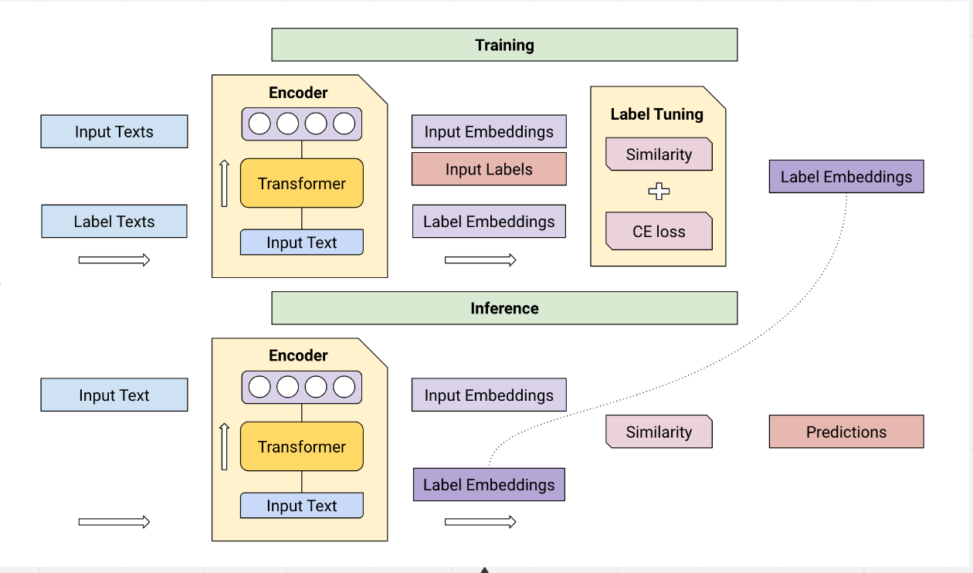
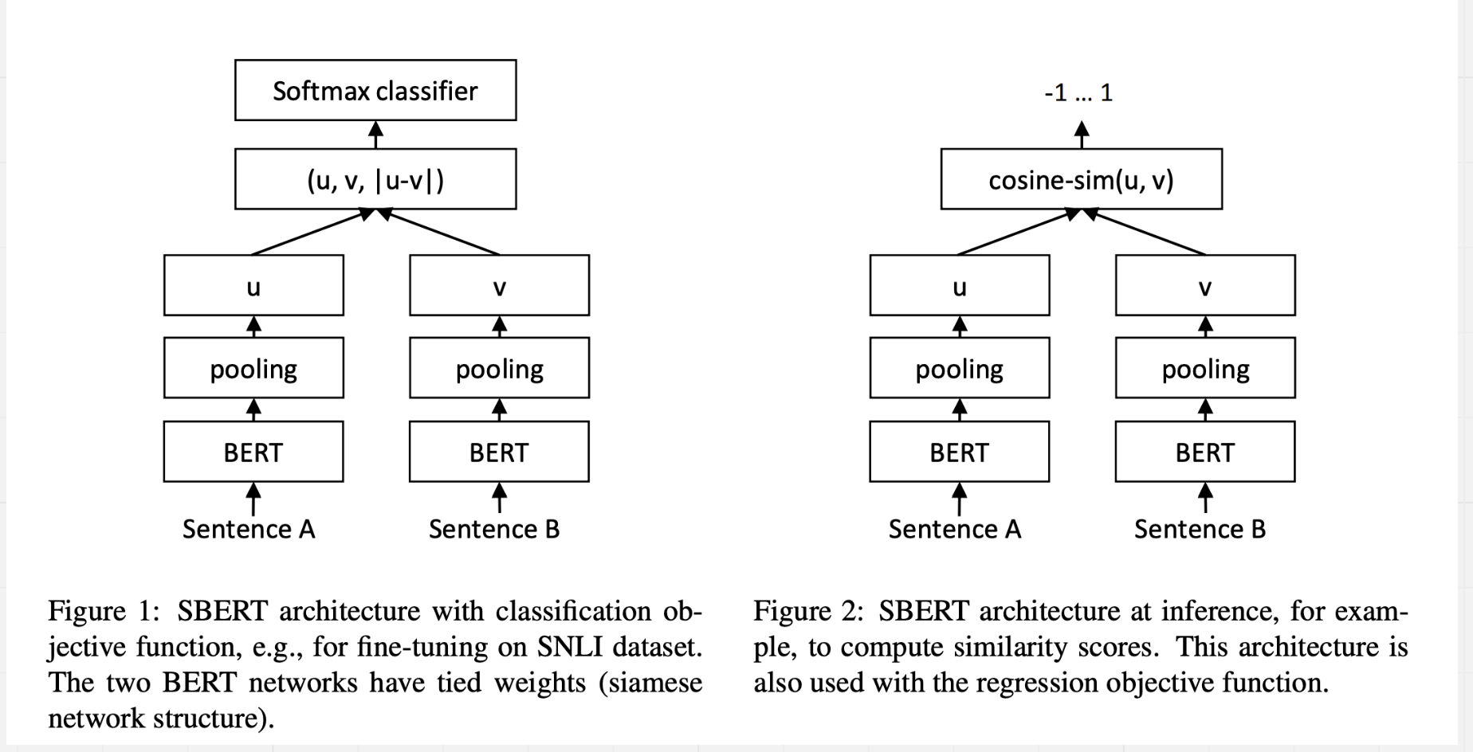
Designing a high level architecture using Siamese network
Few-Shot Learning with Siamese Networks and Label Tuning [1]
Sentence-BERT: Sentence Embeddings using Siamese BERT-Networks [2]
Solves the imbalance problem
Solves duplicate PR & classification problem

Slide 6
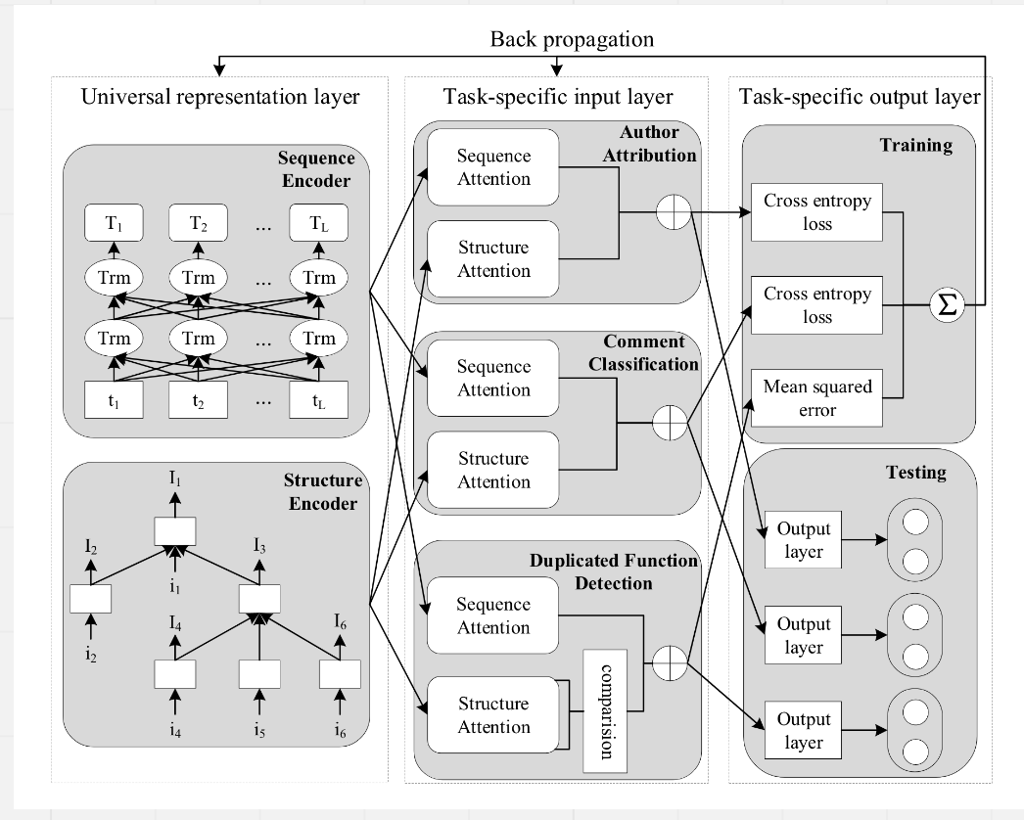
Related Papers
1. CC2Vec: distributed representations of code changes [3]
Focused on single task
Proposed a neural network model that learns representation of code changes guided by their log messages
2. MulCode: A Multi-task Learning Approach for Source Code Understanding [4]
Focused on multi task
Build a sequence encoder with a pre-trained BERT model and a structure encoder with the Tree-LSTM model
3. Recommending Tags for Pull Request in GitHub [5]
Proposed method ‘FNNRec’ which uses feed-forward neural network to analyze titles, description, file paths and contributors.

Slide 7
Research Questions
RQ1: How effective is the proposed model on PR categorization compared to state of the art models?
RQ2: How effective is the proposed model on duplicate PR categorization compared to state of the art models?
RQ3: What’s the benefit of considering both text and code?
RQ4: What if we do not separate training of code and text?

Slide 8
Aiming to submit in ESEC/FSE 2023
Targeting Conference : ESEC/FSE 2023
Submission Deadline: 2nd February 2023
Tasks | Tentative Timeline
Data Collection | Done
Designing and Evaluate 1st version of model | 3-4 weeks
Continuous improvement of model | 3-4 weeks
Gathering experiment results and writeups | 3-4 weeks

Slide 9
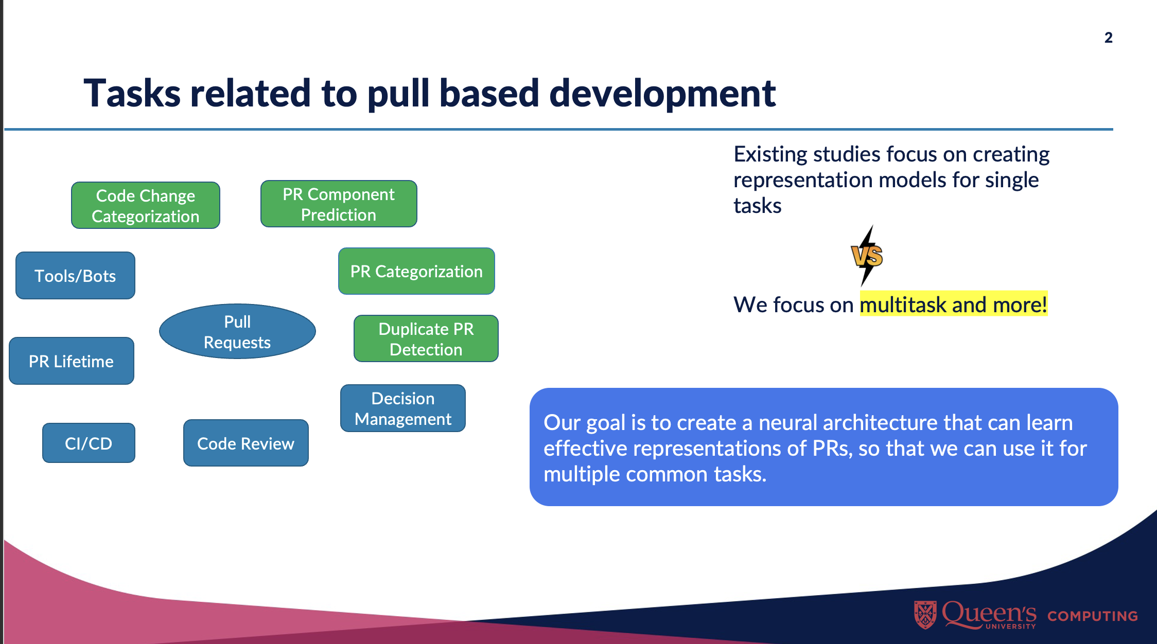
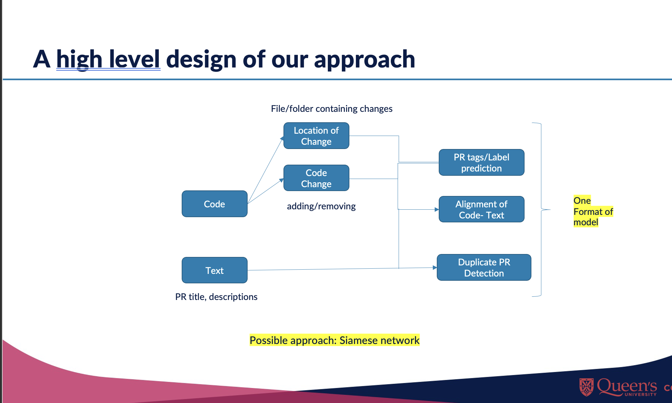
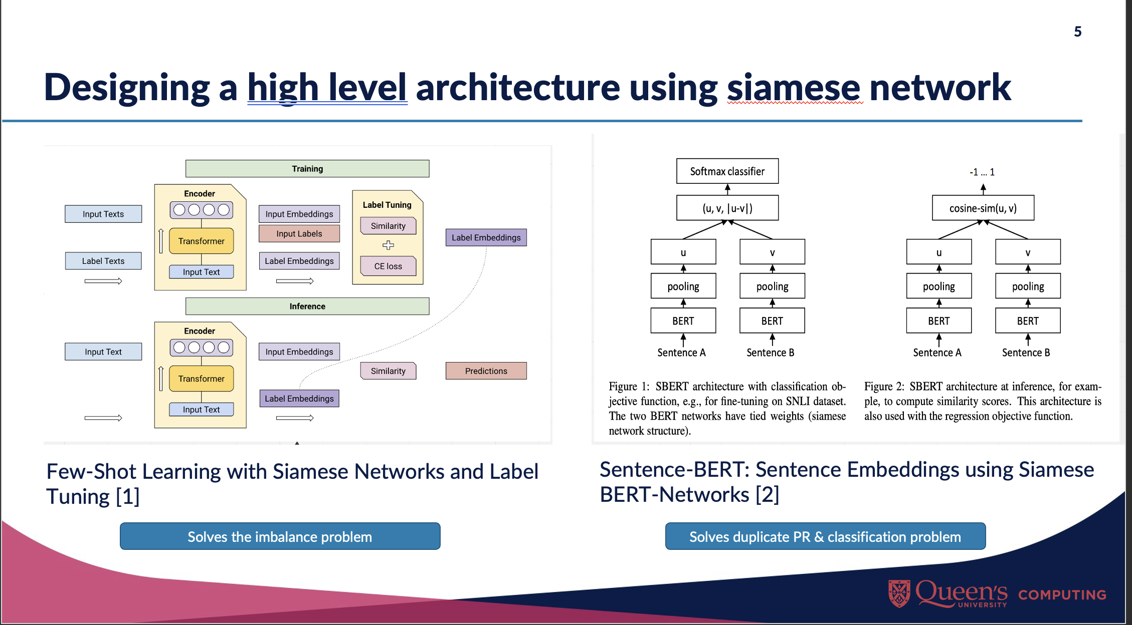
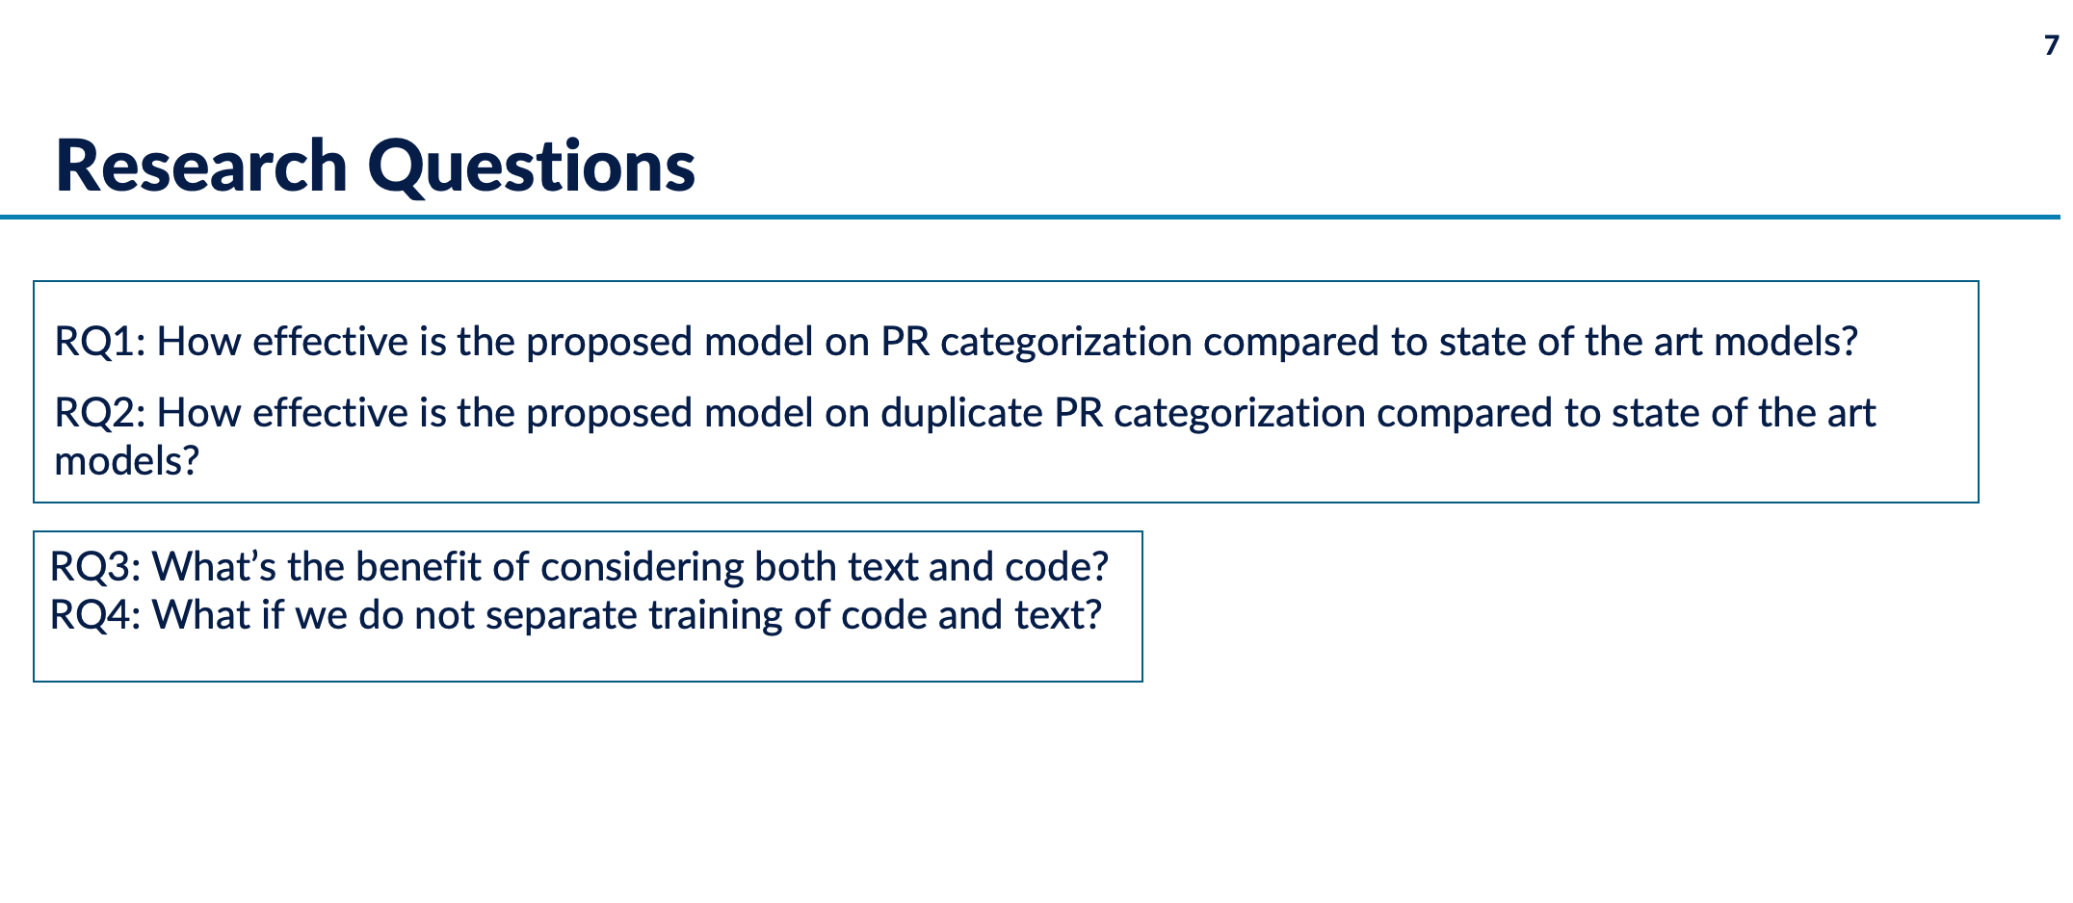
Conclusion

Slide 10
References
Müller, Thomas, Guillermo Pérez-Torró, and Marc Franco-Salvador. "Few-shot learning with siamese networks and label tuning." arXiv preprint arXiv:2203.14655 (2022).
Reimers, Nils, and Iryna Gurevych. "Sentence-bert: Sentence embeddings using siamese bert-networks." arXiv preprint arXiv:1908.10084 (2019).
Hoang, Thong, et al. "Cc2vec: Distributed representations of code changes." Proceedings of the ACM/IEEE 42nd International Conference on Software Engineering. 2020.
Wang, Deze, et al. "MulCode: A Multi-task Learning Approach for Source Code Understanding." 2021 IEEE International Conference on Software Analysis, Evolution and Reengineering (SANER). IEEE, 2021.
Jiang, Jing, et al. "Recommending tags for pull requests in GitHub." Information and Software Technology 129 (2021): 106394.

